Slide 1
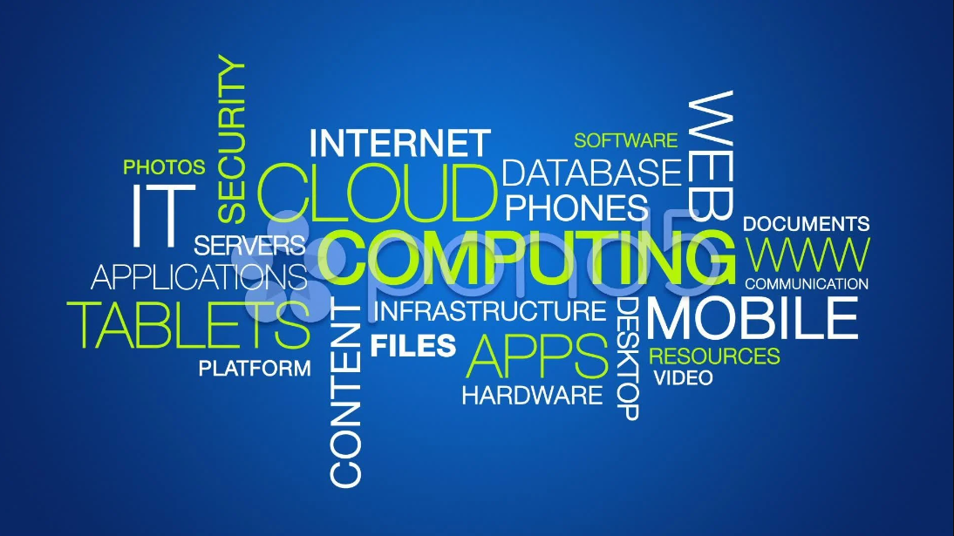
Presented by
Tech King

Slide 2
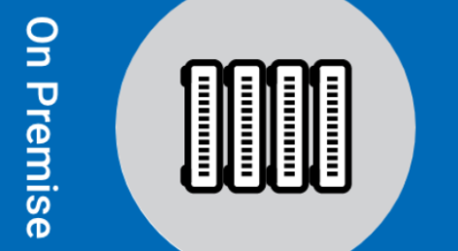
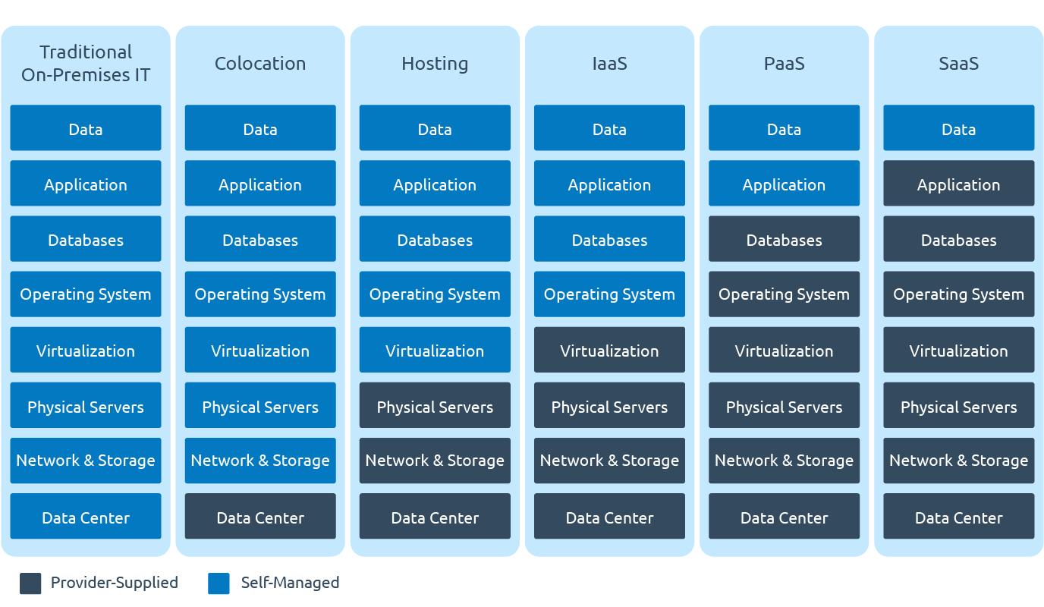
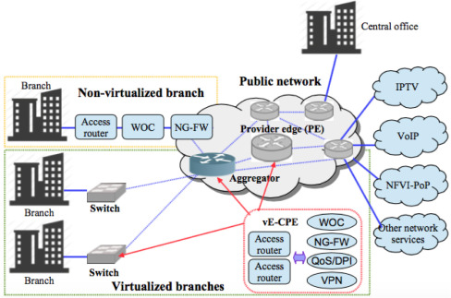
IT deployment models before Cloud:
1. On Premises solutions (CPE – Customer Premises Equipment)

Slide 3
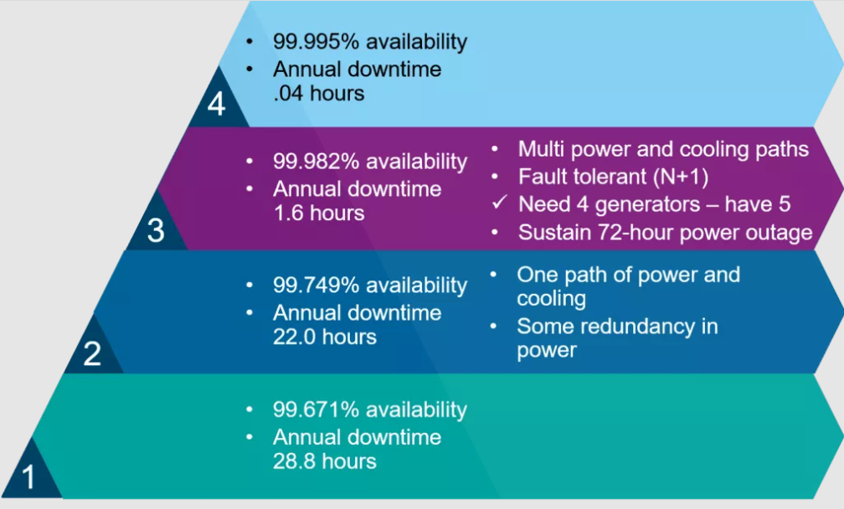
Traditional IT Deployment Models - On Prem and Colo
Data Center Tiers :

Slide 4

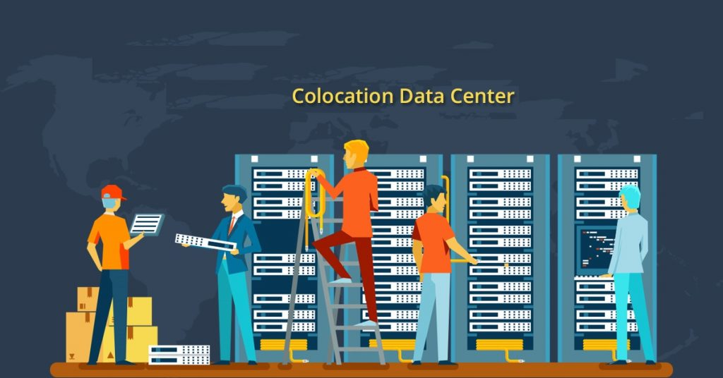
2. Colocation or ‘Colo’ services

Slide 5
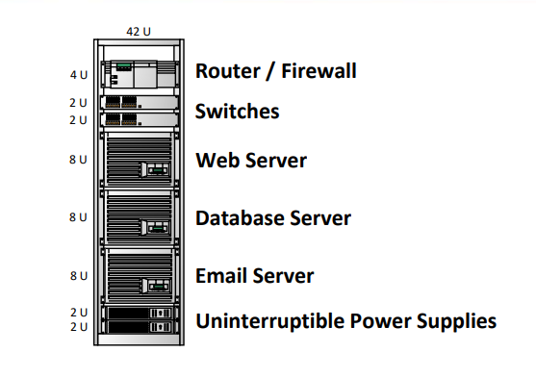
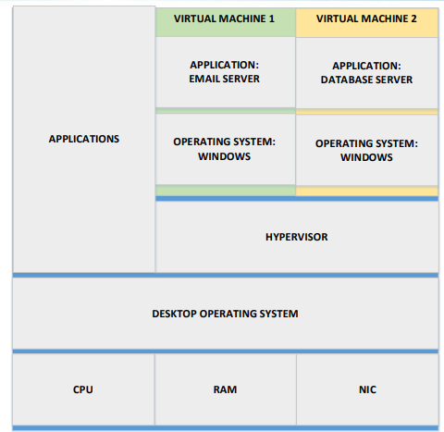
Server Virtualization :
1. VMware ESXi (part of the vSphere suite) 2. Microsoft Hyper-V
3. Red Hat KVM
4. Oracle VM Server Citrix
5. XenServer
6. VMware Workstation
7. Player and Fusion
8. VirtualBox
9. QEMU
10. Parallels

Slide 6
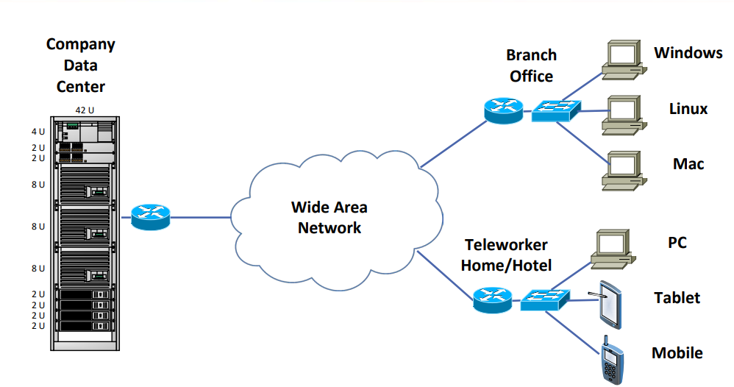
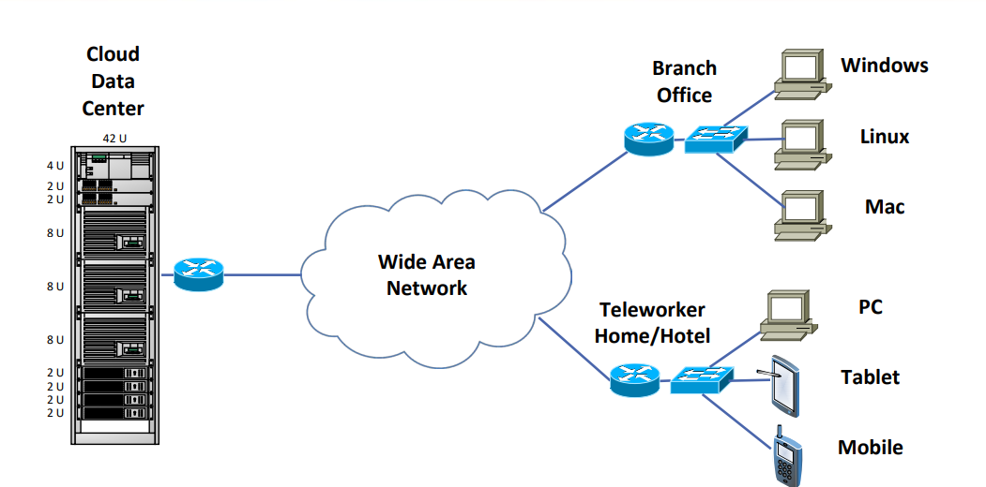
Broad Network Access : Premises and Cloud

Slide 8


